Slide 1
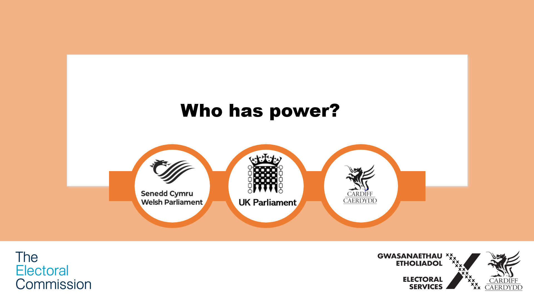

Slide 2

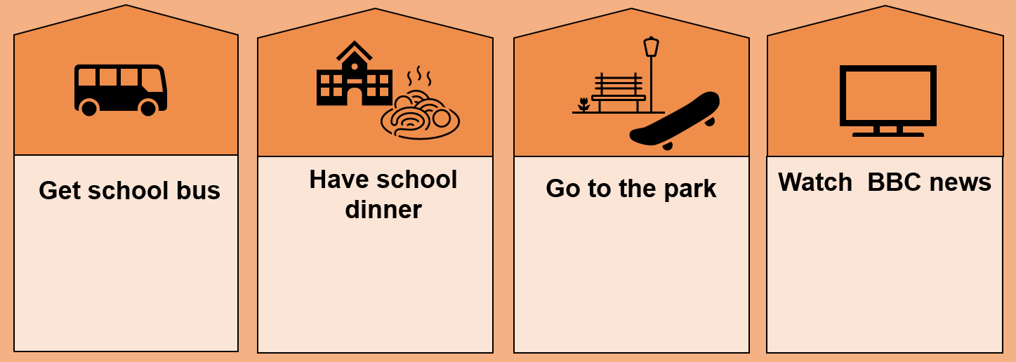

  What is your typical daily schedule?
  Which of these daily activities are impacted by politics, and how?
7am
12.15pm
4pm
6pm
Notes:
Allow students 5 minutes to write down their typical daily schedule and highlight which of their daily tasks they think are impacted by politics.
On the slide is an example of an everyday schedule for a young person going to school.
Ask pupils to think about which of the daily tasks they think are impacted by politics and how?
The answer is all of them: all these daily tasks are impacted by politics, by different governmental organisations. Allow students to share their thoughts on how they think each daily activity is impacted by politics.
Use the next 3 slides to go over the general points about each governmental organisation before asking pupils in slide 6 if they can answer which governmental organisation has power over each daily activity in this example.

Slide 3
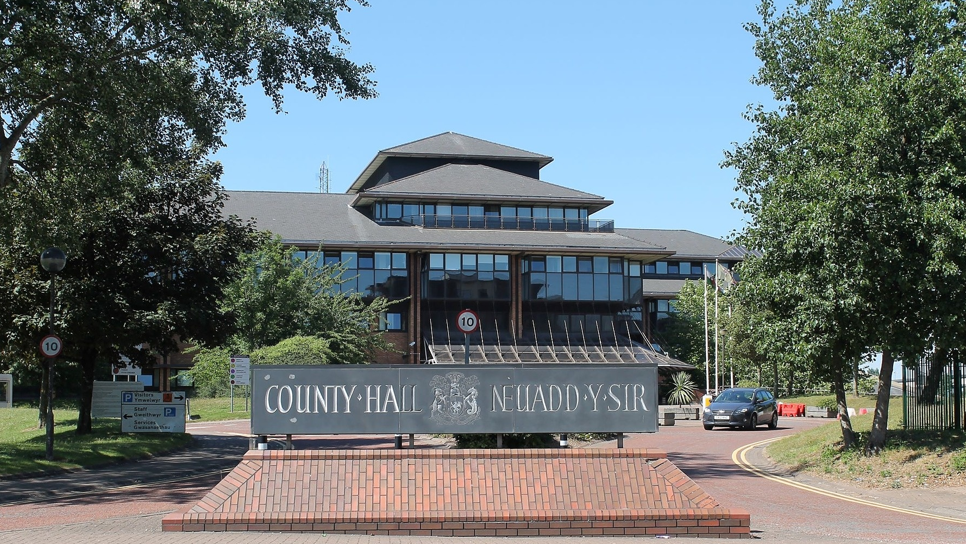

  What powers and responsibilities do Local Governments / Councils have?
  What do you know about this building?
Notes:
Allow students the opportunity to discuss the following points:
- Firstly, if they recognise their local council building
What do they think happens in this building?
Then use the following sub questions as discussion points and to help pupils answer the main question in the heading, before playing the animated video for further information:
Which area is the Council responsible for? – Just the local council area (Cardiff)
What services do you think the council is responsible for? – local services such busses, libraries, waste collection (more examples below)
How are we impacted by the decisions made by the council? – use the examples pupils come up with to discuss how decisions made by their local council have an impact on them. For example: Local councils decide how late libraries are open, so these decisions have an impact on whether we could visit libraries after school hours or not on weekdays.
What powers and responsibilities do Local Governments / Councils have?
In conclusion, Councils manage local services. Council services have a direct impact on local residents and therefore Council’s have a responsibility to ensure the decisions made benefit and are in the best interest of local residents.
Examples of issues Council’s have power over:
Deciding how much is spent on the upkeep of local parks and open spaces [impact: councils need to budget for the upkeep of local parks, or we’d not be able to enjoy these spaces]
Responsibility of local buss Services [impact: the number of busses running have an impact on our ability to commute within the city]
Councils manage the upkeep of roads
Councils manage libraries and local leisure facilities
Councils manage things like waste/bin collections [impact: how often your bins are collected]
Council owned parking services / charges
External link to video incorporated in this slide: Welcome to Your Vote - Local Councils in Wales - YouTube

Slide 4
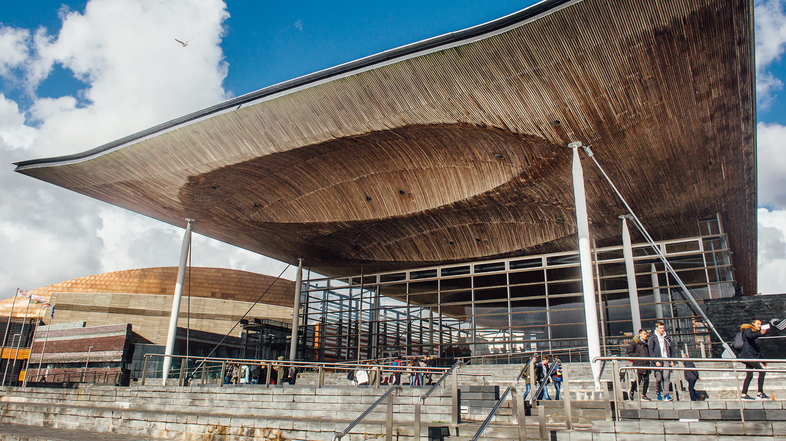

  What powers and responsibilities does the Senedd have?
  What do you know about this building?
Notes:
Allow students the opportunity to discuss the following points:
Firstly, if they recognise the Senedd’s building in Cardiff Bay
What do they think happens in this building?
Then use the following sub questions as discussion points to help pupils answer the main question in the heading, before playing the animated video for further information:
Which area is the Senedd responsible for? – All of Wales
What do you think the Senedd is responsible for? – The Senedd pass laws for all of Wales and set taxes for Wales.
How are we impacted by the decisions made by the Senedd? – Use examples pupils come up with to discuss the impacts of decisions made by Senedd on them/their lives. For Example: the Senedd passed a law to lower the voting age for Welsh elections, so this impacts on how early we can vote.
What powers and responsibilities does the Senedd have?
In conclusion, The Senedd make laws and policies about issues that affect the people of Wales and therefore the Senedd have a responsibility to ensure laws passed are in the best interest of the people of Wales.
Examples of issues the Senedd is responsible for:
Environment: The Senedd passed a law that meant we had to pay for single use plastic bags. The intention is to help protect reduce plastic waste, and the effects on the natural environment. [impact: over time this will make Wales a greener place for us to live, in the immediate term, we had to start paying for plastic bags or use reusable bags when shopping to avoid having to pay each time]
Welsh Language: The Senedd passed a law that made learning Welsh in schools compulsory up to year 11. [impact: pupils must learn some Welsh in school]
Education: how long you stay in school, in Wales the law says that you can leave school in the year when you are 16 and you don’t have to stay in education or training. In England, you have to stay in education or training (although not necessarily at school) until you are at least 18. [impact: young people in Wales have the choice to leave school earlier if they wished to]
Welsh Taxes: The Senedd make laws to decide on how much income tax is in Wales and how tax money is spent [impact: income tax is deducted from salaries, so these laws have an impact on how much people in Wales are taxed from their salaries]
External link to video incorporated in this slide: Welcome to Your Vote - The Senedd - YouTube

Slide 5
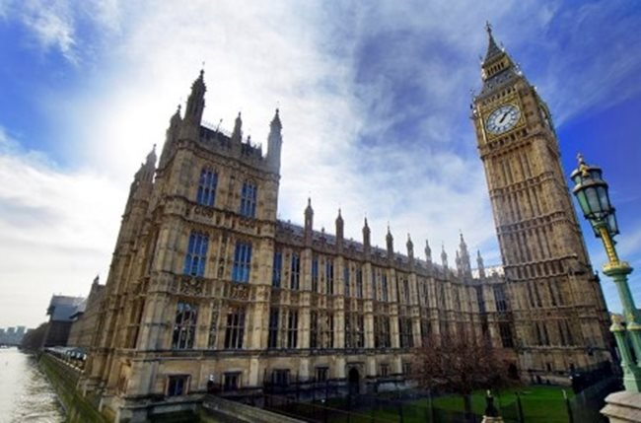

  What powers and responsibilities does the UK Parliament have?
  What do you know about this building?
Notes:
Allow students the opportunity to discuss the following points:
- Firstly, if they recognise the UK parliament building
What do they think happens in this building?
Then use the following sub questions as discussion points and to help pupils answer the main question in the heading, before playing the animated video for further information:
Which area is the UK Parliament responsible for? – All of the UK
What do you think the UK Parliament is responsible for? – UK Parliament passes laws and debate important issues that affect all of the UK. (UK Parliament also hold UK Government to account.
How are we impacted by the decisions made by the UK Parliament? - Use examples pupils come up with to discuss the impacts of decisions made by UK Parliament on them/their lives. For Example: UK Parliament passed a law that states the minimum age you have to be, to drive in the UK
What powers and responsibilities doe the UK Parliament have?
In conclusion, UK Parliament passes laws that have an impact on people across the UK therefore, UK Parliament has a responsibility to ensure these laws and regulations are in the best interest of the people of the UK.
Examples of issues UK Parliament has power over:
Deciding whether we (the UK) go to war or not
How much is spent on the NHS
External link to video incorporated in this slide: Welcome to Your Vote - UK Parliament - Wales - YouTube

Slide 6
  What is your typical daily schedule?
7am
12.15pm
4pm
6pm
  Who is responsible for the services we looked at here?
Local council
Local council
UK Parliament
Senedd
Notes:
We’ve established that many aspects of our day-to-day life is impacted by politics/decisions made by politicians in several governmental organisations. We have also covered what issues each of the 3 organisations have power over, so now pupils should be able to answer which of the 3 organisations impact/or have power over each of services in this example / their own daily routine they previously noted.
7am – get the school bus
School bus services are the responsibility of the local council
12.15pm – have a school dinner
Guidelines for healthy eating in schools are published by the Senedd
4pm – go to the park
Parks, leisure and libraries are managed by the local council
6pm – watch the BBC news
The BBC is funded by the UK Parliament

Slide 7



  Do we have any power?
Who has power to make decisions? | Council Members (Councillors) | Members of the Senedd | Members of Parliament
How do these decision makers get into positions of power? | Local Government Elections | Senedd Elections | UK Parliamentary Elections (General Elections)
Notes:
Now that pupils have understood that each governmental organisation has powers to influence or make decisions about issues/services that have an impact on all of us – pupils can explore what powers they have.
Use the two questions (for each governmental organisation) to help pupils answer the main question in the heading of the slide (by clicking or pressing the ‘entre’ key when you are in slide mode, each answer will appear).
Do we have any power? Yes, we have a power through our vote to influence who is elected in each of these elections.

Slide 8

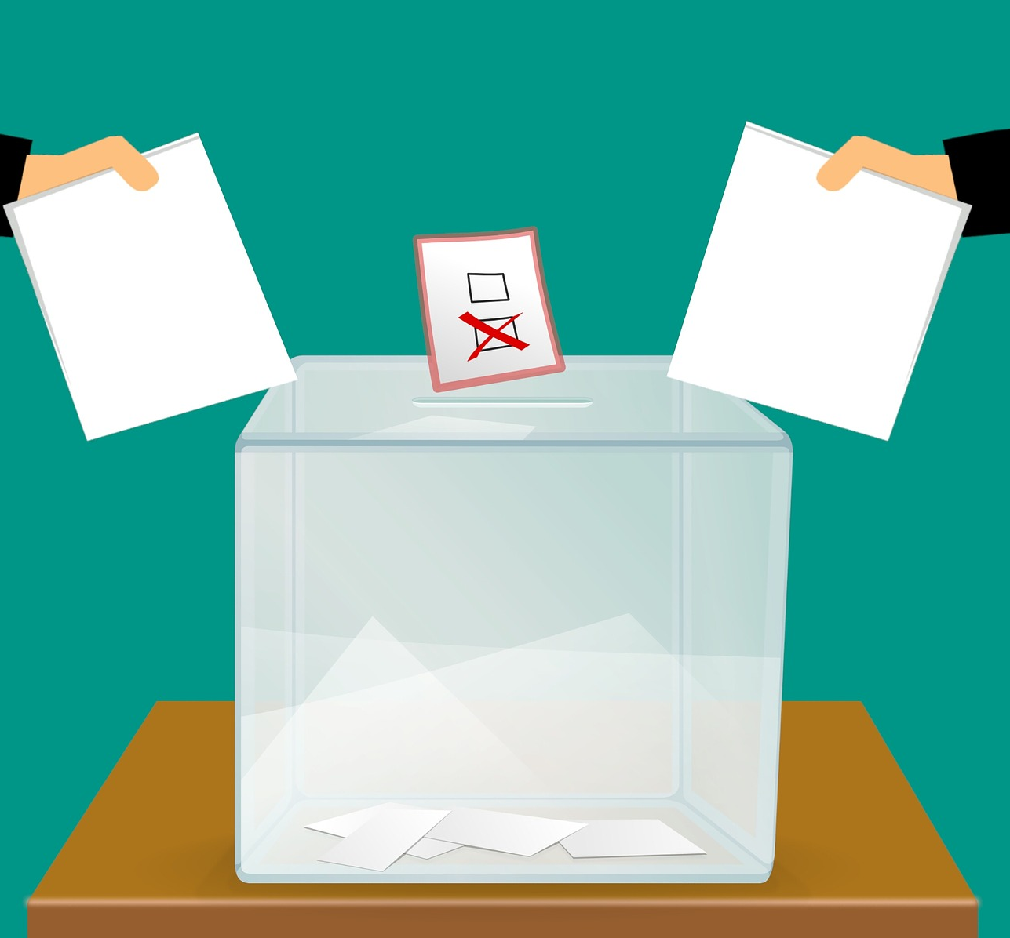

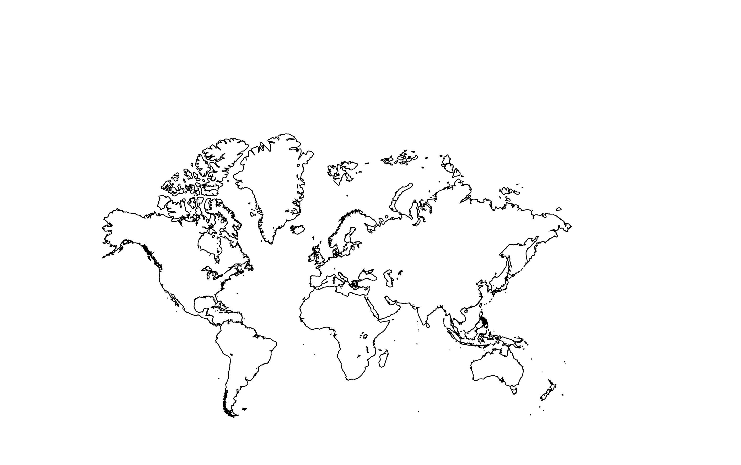

  Do we have any responsibilities?
  What influences your decisions?
Friends?
Social Media?
Opinions of experts?
Influencers / Celebrities?
Parents/Carers?
TV?
Holiday Destination?
Money & Finances?
Notes:
If elected members have power to make decisions that impact upon us – their responsibility is to ensure they make decisions that will protect us or be in our best interest.
If we have the power to vote which impacts who is elected into positions of power, then what is our responsibility? Our responsibility to is to use our vote for who we think will consider our best interest when making decisions / our responsibility is also to make a conscious decision when casting a vote.
Everyone makes decisions every day. Whether these are big or small decisions, there are lots of factors which influence decision making.
Ask students to think about:
What influences the decisions we make every day?
What influences what you watch on TV or do at the weekend?
Ask students to imagine they have a decision to make about their futures. Suggestions could be what to do after they’ve finished school, where to go to university or college, or where to go on holiday.
Ask what would be important to them when making this decision?
Repeat the exercise, instead asking the group what would be important to them when making the decision of who to vote for?
Finally play the animated video in the slide to help pupils think about how to decide who to vote for – this is also an introduction to next lesson.
External link to video incorporated in this slide: Welcome to Your Vote - Introduction to Election Campaigns - Wales - YouTube

Slide 9
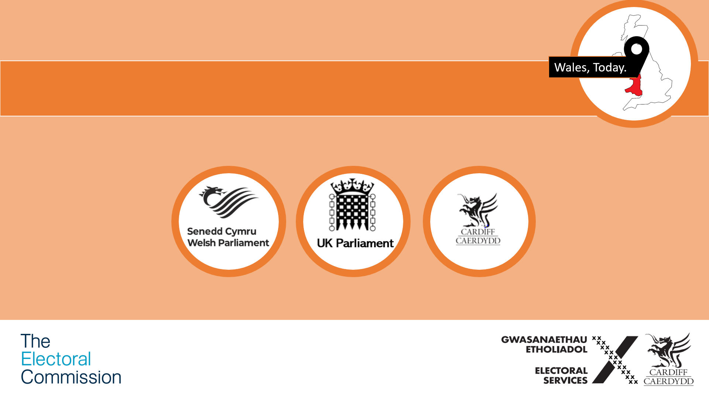
Next lesson:
  Should we vote? And how do we decide who to vote for?

